Slide 1

BARS (Beer Auto Recognition System)
박창준 이정민 김청빈 서재훈 황현제

Slide 2


INDEX
01. Intro
02. Feature
03. Process
04. Use case
05. Q&A

Slide 3
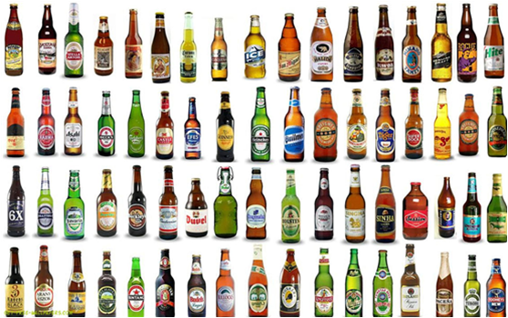
[Intro]

Slide 4
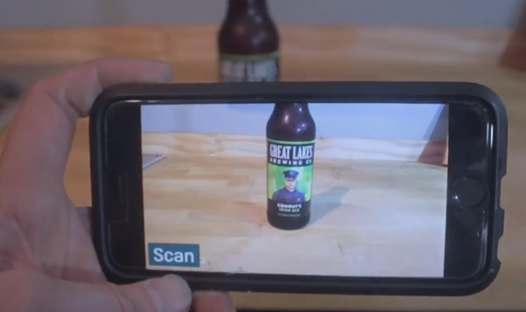
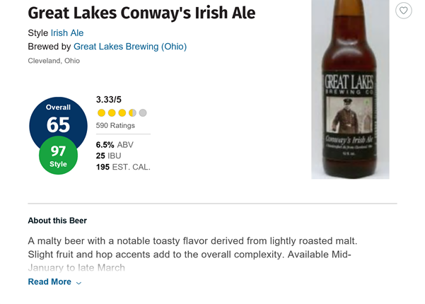
[Feature]
Process

Slide 5
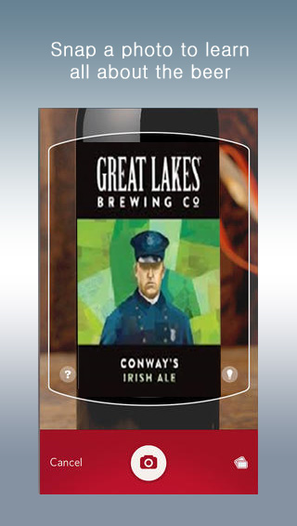
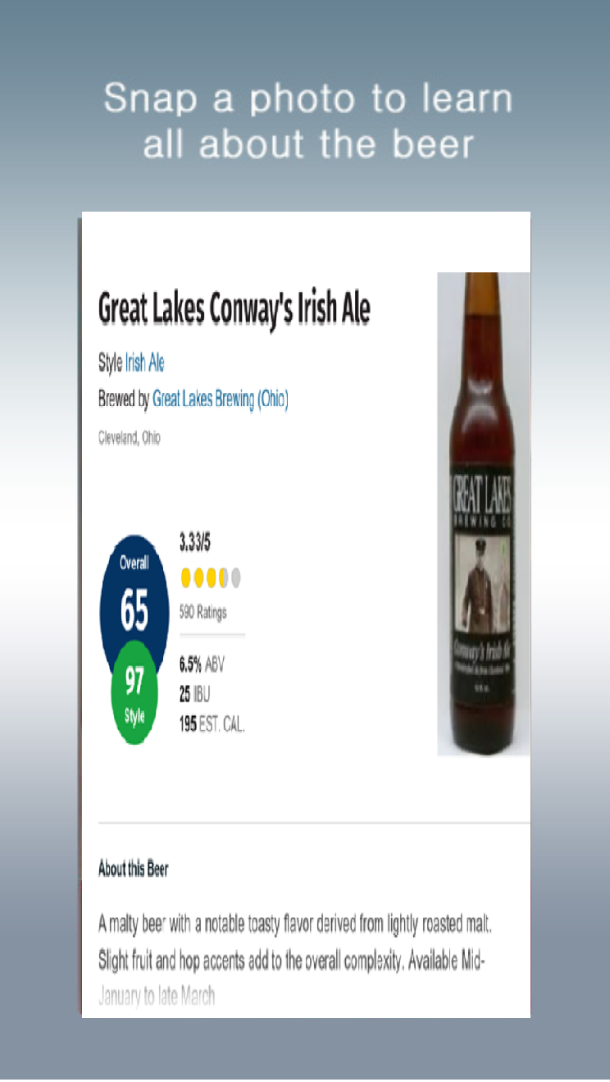
[Feature]
UI diagram

Slide 6
[Process]
Image –Classification –Model based on deep learning
1)‘Pytorch framework’ for data learning
2) Crawl image data by using
‘Selenium’ and ‘Beautiful Soup’ liabary

Slide 7
[Use case]
Case1)
You went to a convenience store to grab some beers to drink. You are fed up with Korean beers that you’ve been drinking for years. Just then, you notice that there are lots of imported beers that you’ve never drank before. There are too many choices and it’s even hard to read the label because it’s written in foreign language. At the time you run the BARS app and take some photos of those beers and upload it. Now, You have all the info about those beers which will make you a smart consumer.
Enjoy the beer!
Case2)
You are a traveller visiting Korea. You wonder how the Korean beer will taste like. It’s seems like “Hite beer” and “Cass Beer” is the most famous beer in Korea. Take photos of two beers. upload it on the BARS app. You notice that the rating of those two beers are pretty low. You put those beers back on the shell and take some more photos of Korean beer. After a while, you find a beer with rather high rating. Grab it and enjoy it.

Slide 8
[ Q&A ]

Slide 9
Thank U

